Slide 1
Future of ICP

Slide 2
What happened since the completion of
2011 ICP?
The UN Statistical Commission established the Friends of the Chair (FOC) group at the 45th Session in 2014
A group with 15 members was established.
Objective was to conduct an extensive review of the ICP and provide recommendations
The FOC submitted its Initial Report in 2015
Final Report with conclusions and recommendations was submitted in 2016.
The UNSC endorsed the recommendations of the FOC in its 47th Session in 2016.
The main recommendation is to conduct the next round of ICP with 2017 as the benchmark year.

Slide 3
Recommendations for future ICP rounds by FOC
The main finding is that a six-year interval between rounds is too long
ICP results are needed every two or three years
Reduce the size of the Executive Board
Reduce size from 25 members to 16
Eleven countries – one or two from each of the regions
World Bank, IMF, Statistics Division of the UN; Eurostat; and OECD
ADB, AFDB; CIS-STAT; ECLAC; and ESCWA to have observer status

Slide 4
Recommendations - continued
Establish a permanent Global office
Located at the World Bank
Provide permanent structure; greater continuity; and preserve institutional memory
A staff member of the World Bank act as the Global Manager
Executive Board to be renamed as the Governing Body
Inter-Agency Coordinating Group
Replaces the current Regional Coordinators Group
Technical Advisory Task Force to replace Technical Advisory Group
With reduced size

Slide 5
Way forward – UNSC Recommendations

Slide 6
Way forward – UNSC Recommendations
Adoption of Rolling Benchmark approach
An approach similar to that of Eurostat and OECD
Implement this approach for 2017 and beyond
Data quality and detailed indicators – the following indicators have been suggested
Consumer goods and services – CPI sub-indices at a detailed level
Capital goods and construction: sub-indices of producer price index
Housing, rentals: rental price index, quantity/quality indicators
Non-market services, general government salaries: sub-indices of wages index, labour cost index, input/output indicators
GDP: yearly expenditure data and national accounts deflators

Slide 7
Way forward – UNSC Recommendations
No new methodological innovations in the next round
Integrating ICP and CPI survey activities
Streamlining the process of establishing item lists and the use of importance indicators
Improving the availability and quality of input data for rents, government services and construction
Streamlining the use of productivity adjustments for government services
Fine-tuning the global linking procedures
Quality assurance of resulting PPPs and measures of reliability

Slide 8
Recent Research

Slide 9
Real and Nominal World and Regional GDP (in billions of US dollars – current prices)
Country | Real GDP 2005 | Real GDP 2011 | Nominal GDP 2005 | Nominal GDP 2011
World GDP OECD-Eurostat Asia-Pacific | 54,975 43,019 11,070 | 90,646 58,678 26,232 | 44,308 39,935 4,464 | 70,294 55,360 12,113
Source: World Bank, Results from ICP 2005 and 2011.
Growth in World Economy from 2005 to 2011
Real GDP in PPPs - 1.6489
Nominal GDP in XR’s - 1.5865

Slide 10
World Economy in PPP and XR terms
We note that change in world GDP in PPP terms (in current prices) over the period 2005 to 2011 is different from the change measured in exchange rates.
This is likely to cause a lot of confusion among users
Is it possible to synchronise these two measures
PPPs and exchange rates are all expressed relative to US dollars.
US dollar is used as the numeraire or reference currency as PPPs are determined up to a factor of proportionality
In our paper we propose a normalization for PPPs which ensures that world GDP in any given year would be the same in PPP and exchange rate terms
In simple terms, this means adjusting all PPPs using a constant that equals the ratio of world GDP in PPP and Exchange rate terms
This is the approach we use in rest of this paper

Slide 11
Global Inflation and Growth at the country level
We start with the decomposition of changes in GDP at the country level over time – this serves as a template for the world economy.
GDP deflator
GDP growth

Slide 12
Global Inflation and Growth
The objective is to decompose the total real GDP ratio into a price index and a quantity index,
$\frac{RGDP^{t}}{RGDP^{s}}=WP\left(s,t\right)WQ(s,t)$.
We need to find formulae that satisfy this equation leading to measures of world growth and inflation in PPP terms.
Similar expressions are derived in the paper for measures based on exchange rates.
The growth and inflation measures on the right hand side can be direct or can be chained.
We use symetric decompositions – symmetric with respect to the base and current periods.

Slide 13
Fisher-type Decomposition
In deriving this decomposition, we make use of the following standard index number result
The main trick is to express our problem in a form where this result can be used.

Slide 14
Laspeyres-type Decomposition
We make use of the first equality on the RHS of value change decomposition.
Weighted harmonic price change adjusted for PPP changes – weights are current period shares
Weighted arithmetic mean of country specific growth rates – based period share of the country in the world

Slide 15
Paasche-type Decomposition
We make use of the second equality on the RHS of value change decomposition.
Weighted arithmetic mean of country specific inflation rates adjusted for PPP changes – based period share of the country in the world
Weighted harmonic of country-specific growth rates – current period share of the country in the world

Slide 16
Fisher-type Decomposition
Since the Laspeyres and Paasche decompositions make use of base and current period country shares, a symmetric decomposition is given by taking geometric average. This gives measures of global growth and inflation as:

Slide 17
Global Inflation and Growth
The Fisher global growth shows that it is important to make use of country-specific shares in the global economy in both periods.
Global inflation estimates rely both on domestic inflation as well as PPPs in both periods.
This measure differs from the formula given in Diewert (2014).
We can derive global inflation and growth estimates based on exchange rates. Then we have:

Slide 18
Global Inflation and Growth - Sato-Vartia-type Measures
Using the logarithmic mean, the ratio on the left can be written as a sum on the right hand side.
where

Slide 19
Sato-Vartia-type Measures
Then the World Inflation and World growth can be measured using:
The global growth and inflation are given by:
Price change
PPP change

Slide 20
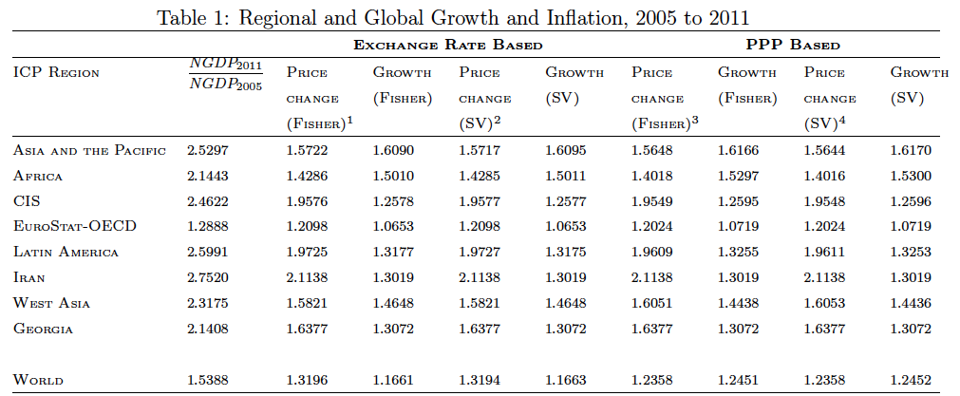
Global Inflation and Growth – 2005 to 2011
Source: Rao, Rambaldi and Balk (2015)
We normalize so that nominal GDP growth and growth in real GDP at current prices is equal.

Slide 21
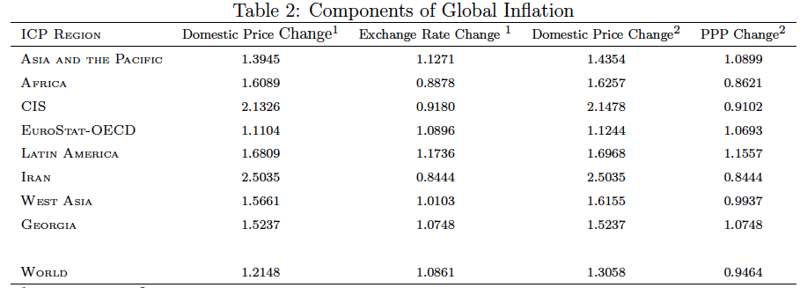
Decomposition of Global Inflation
Now we turn to global inequality

Slide 22
Standard Errors for PPPs

Slide 23
Aggregation Methods for PPP Computation
CPD method:
GEKS Method:
Geary-Khamis Method:
Weighted CPD (Rao Method):
Ikle Method:
Notes:
The geometric lag has the advantage of being relatively simple. But there are many instances where it is unreasonable to assume that the first lag weight is the largest (e.g., the inflation example).

Slide 24
Stochastic framework based on CPD Model
We start with the CPD Model:
We express the model as:
We rewrite the CPD model in three equivalent forms:
Notes:
The geometric lag has the advantage of being relatively simple. But there are many instances where it is unreasonable to assume that the first lag weight is the largest (e.g., the inflation example).

Slide 25
Notes:
The geometric lag has the advantage of being relatively simple. But there are many instances where it is unreasonable to assume that the first lag weight is the largest (e.g., the inflation example).

Slide 26
Notes:
The geometric lag has the advantage of being relatively simple. But there are many instances where it is unreasonable to assume that the first lag weight is the largest (e.g., the inflation example).

Slide 27
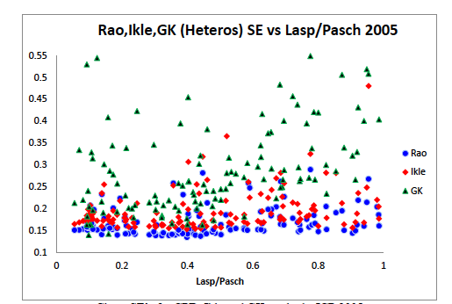
Notes:
The geometric lag has the advantage of being relatively simple. But there are many instances where it is unreasonable to assume that the first lag weight is the largest (e.g., the inflation example).

Slide 28
Notes:
The geometric lag has the advantage of being relatively simple. But there are many instances where it is unreasonable to assume that the first lag weight is the largest (e.g., the inflation example).

Slide 29
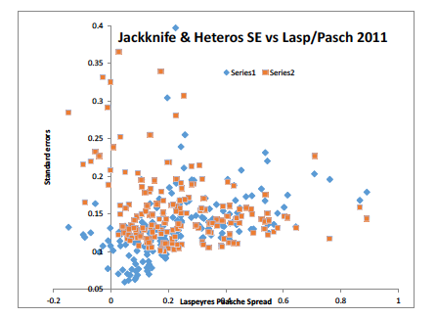
Weighted CPD Method
Notes:
The geometric lag has the advantage of being relatively simple. But there are many instances where it is unreasonable to assume that the first lag weight is the largest (e.g., the inflation example).

Slide 30
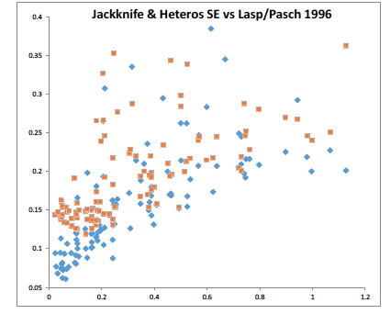
Weighted CPD Method
Notes:
The geometric lag has the advantage of being relatively simple. But there are many instances where it is unreasonable to assume that the first lag weight is the largest (e.g., the inflation example).

Slide 31
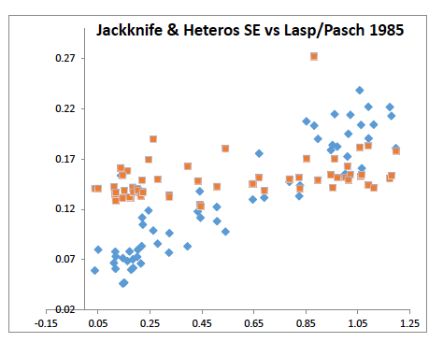
Weighted CPD Method
Notes:
The geometric lag has the advantage of being relatively simple. But there are many instances where it is unreasonable to assume that the first lag weight is the largest (e.g., the inflation example).

Slide 32
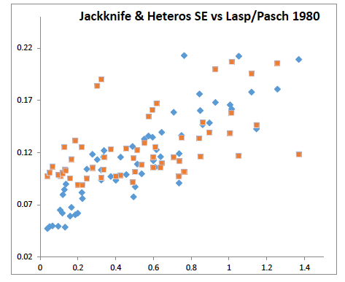
Weighted CPD Method
Notes:
The geometric lag has the advantage of being relatively simple. But there are many instances where it is unreasonable to assume that the first lag weight is the largest (e.g., the inflation example).

Slide 33
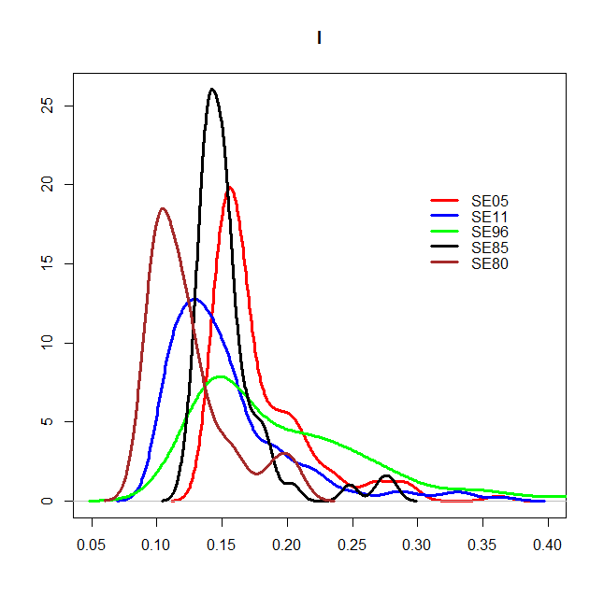
Distribution of Standard errors of PPPs
Weighted CPD with Heteroskedastic errors
Notes:
The geometric lag has the advantage of being relatively simple. But there are many instances where it is unreasonable to assume that the first lag weight is the largest (e.g., the inflation example).

Slide 34
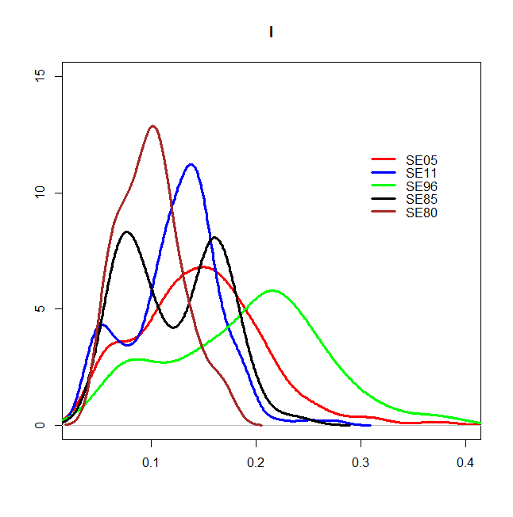
Distribution of Standard errors of PPPs
Weighted CPD with jack-knife standard errors
Notes:
The geometric lag has the advantage of being relatively simple. But there are many instances where it is unreasonable to assume that the first lag weight is the largest (e.g., the inflation example).

Slide 35
Any other suggestions for improving ICP?

